Slide 1

Wallace: A Software to Estimate Species Distributions and Quantify Biodiversity Changes
The Wallace team

Slide 2
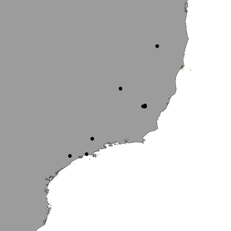
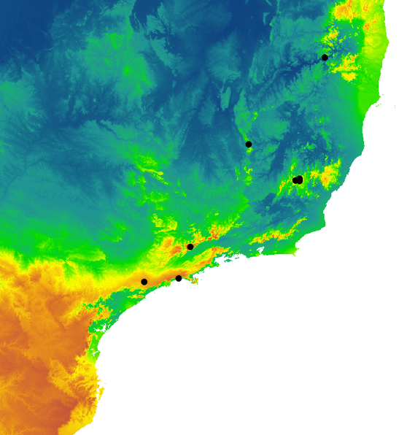

Correlative models hyper-summarized
Presence localities
Algorithm
Suitability map
Environmental variables
Notes:
Image credit: Adapted by A. Paz from A. Paz, Z. Spanos, J.L. Brown, M. Lyra, C. Haddad, M. Rodrigues, and A. Carnaval. 2019. Phylogeography of Atlantic Forest glassfrogs (Vitreorana): when geography, climate dynamics and rivers matter. Heredity 122:545–557.

Slide 3
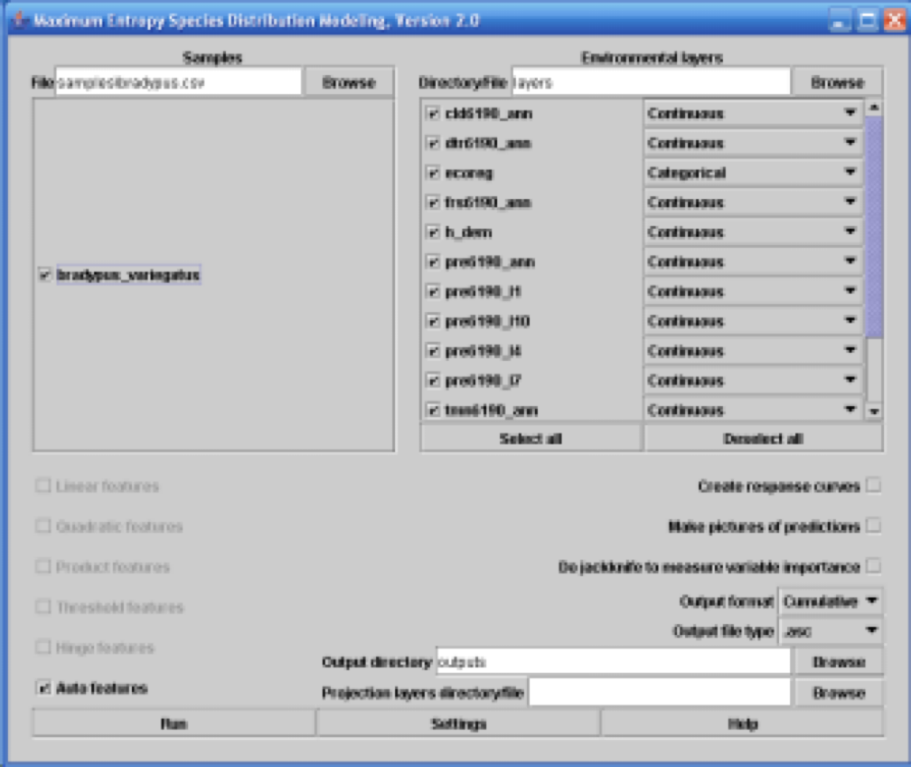
The problem with graphical interfaces
Presence localities
Environmental variables
RUN
Notes:
Image source: Maxent.

Slide 4
The problem with graphical interfaces
Default options might not be the best
Even if it runs it does not mean it is a good model
Not all options are available in these interfaces
They require the use of multiple softwares

Slide 5

Modeling is not just CLICK CLICK

Slide 6

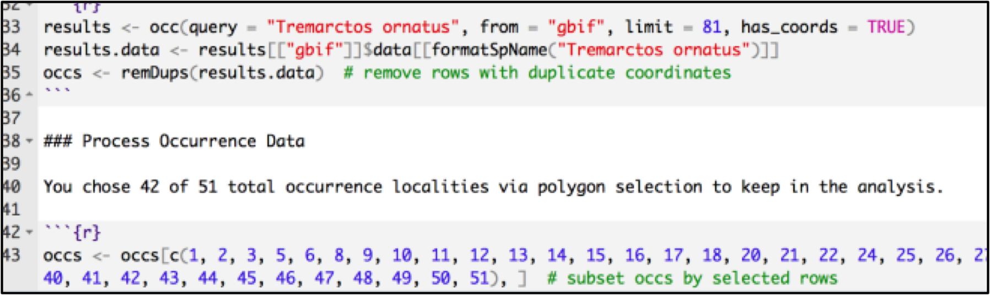
sooo coding?
BUT:
Limits access by several researchers
Prone to mistakes
Case specific

Slide 7
What did we want?
A software allowing for balance between automation (easy use) and supervision:
Automate repetitive aspects
Users have to make informed methodological decisions (software y biology).
A flexible and general graphical user interface

Slide 8
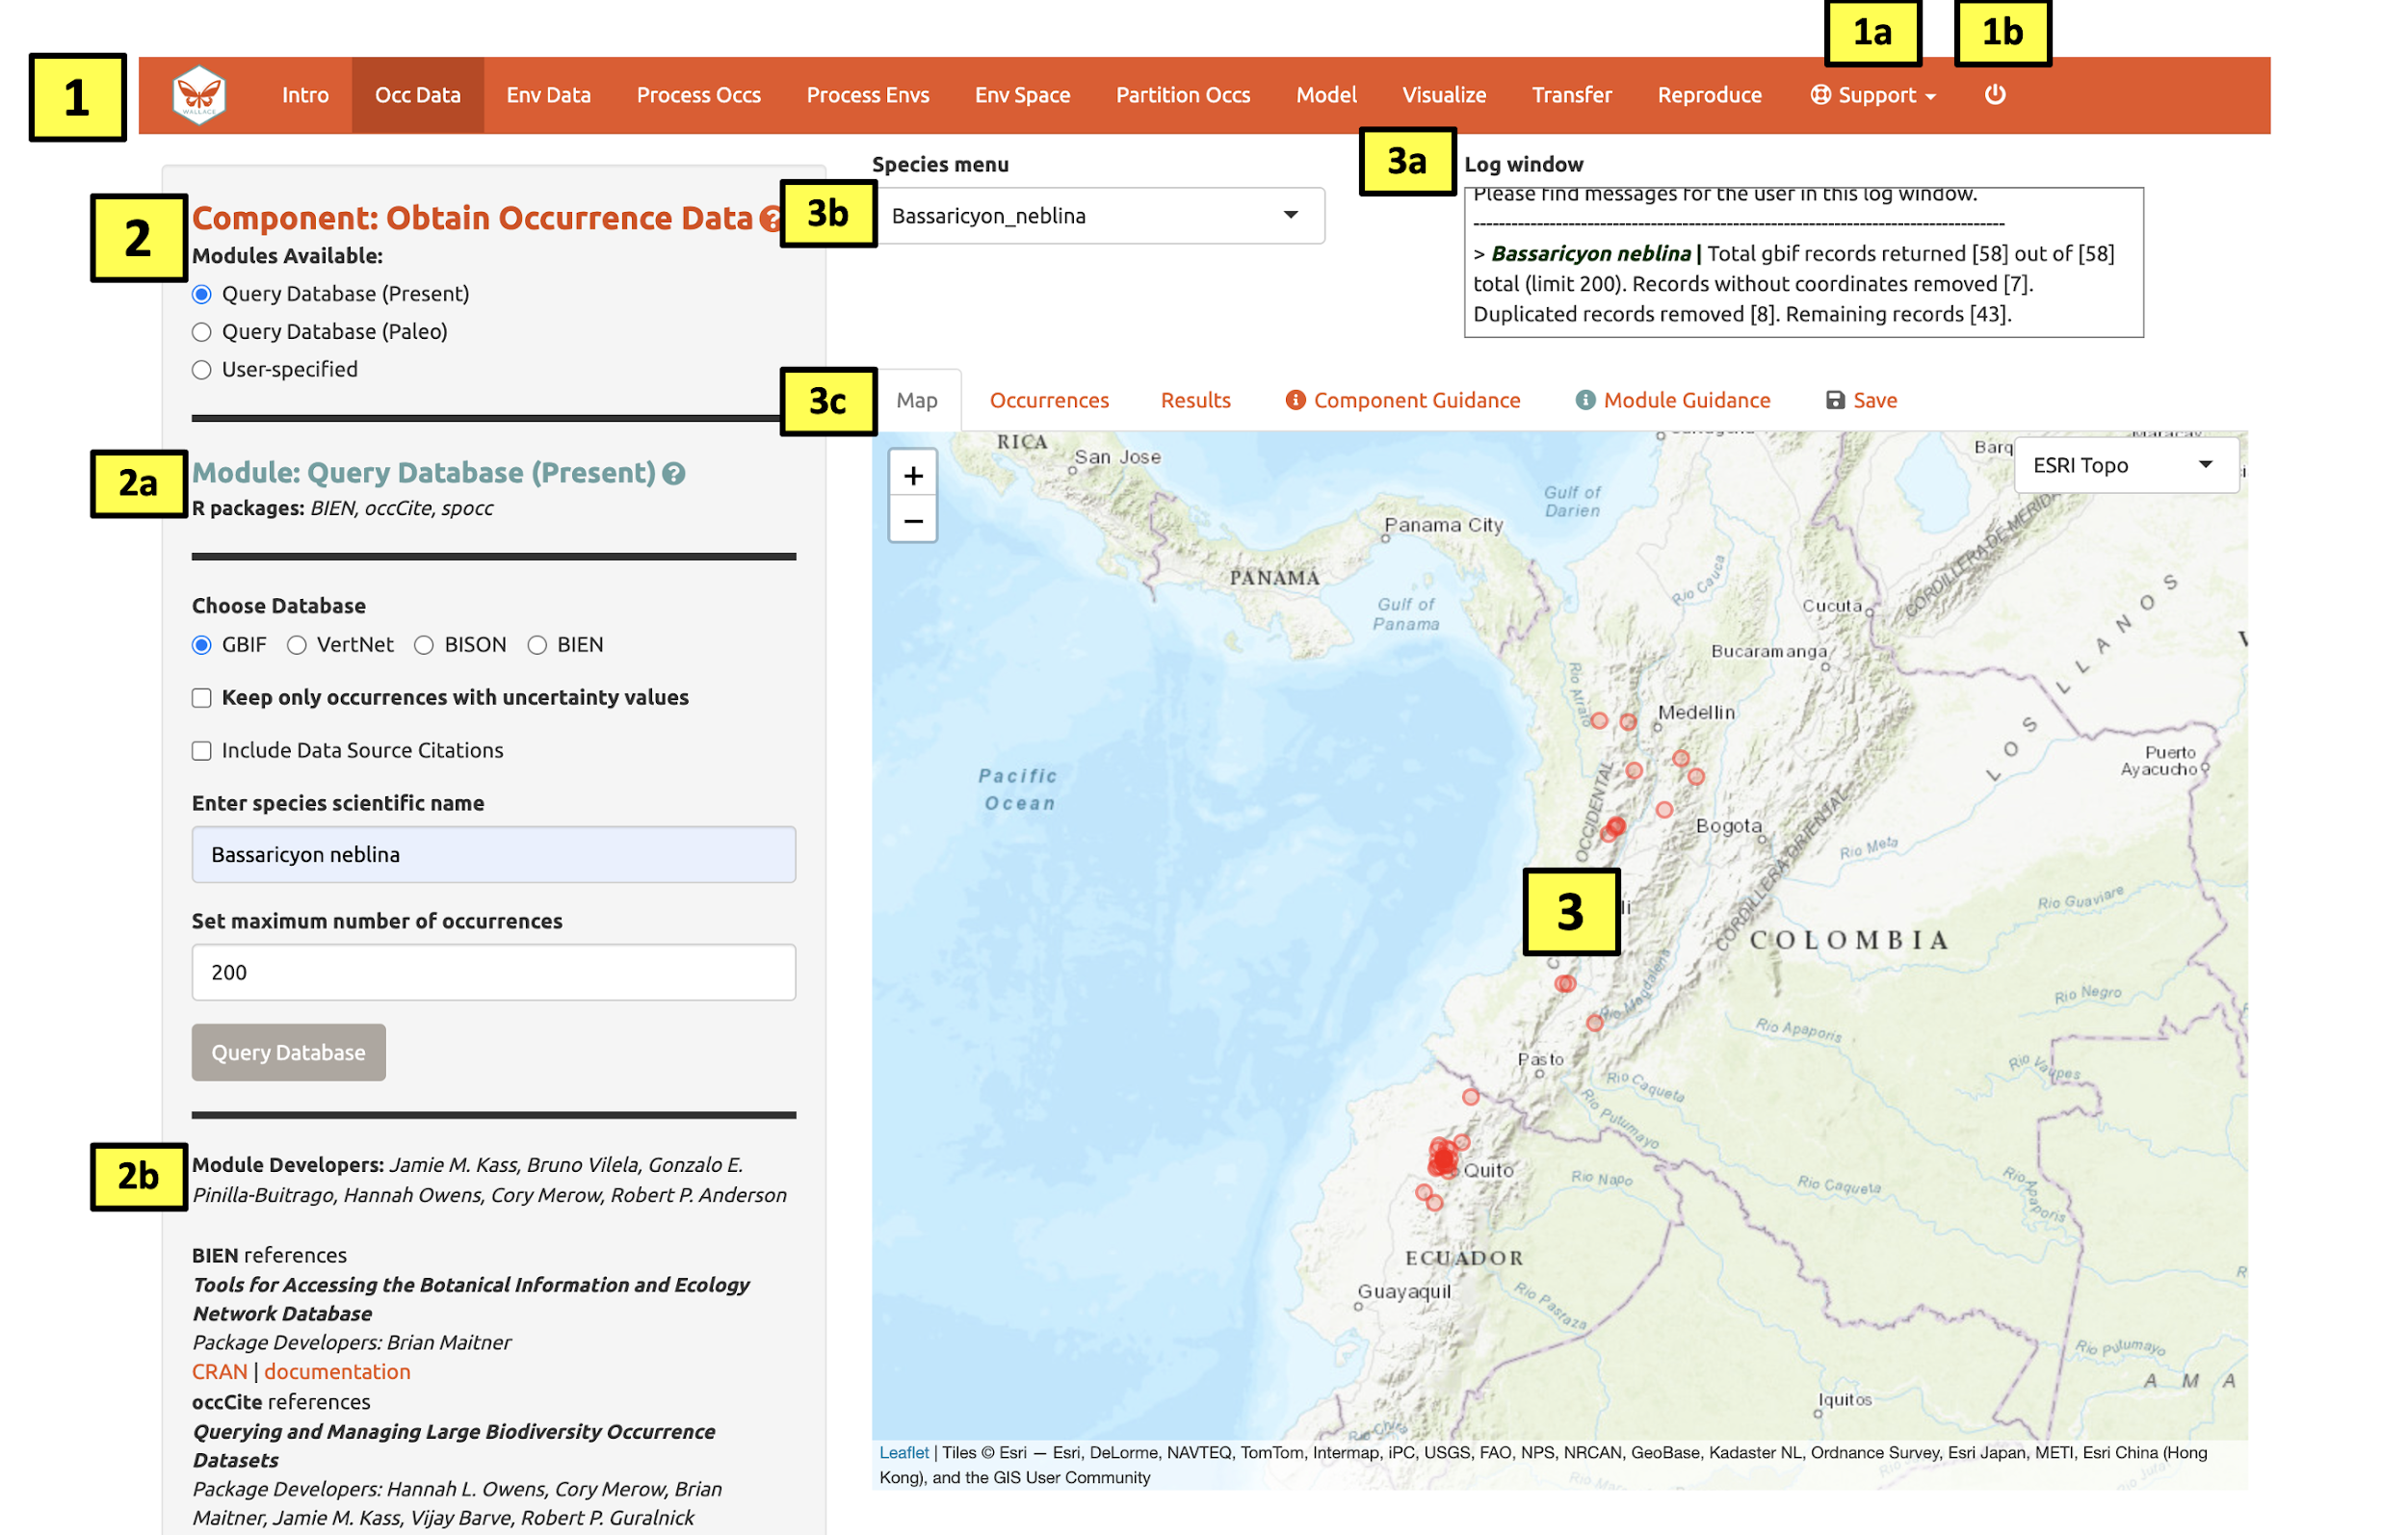
Wallace EcoMod
A graphical interface with a workflow for species distribution modeling
Notes:
Image credit: Wallace EcoMod.

Slide 9
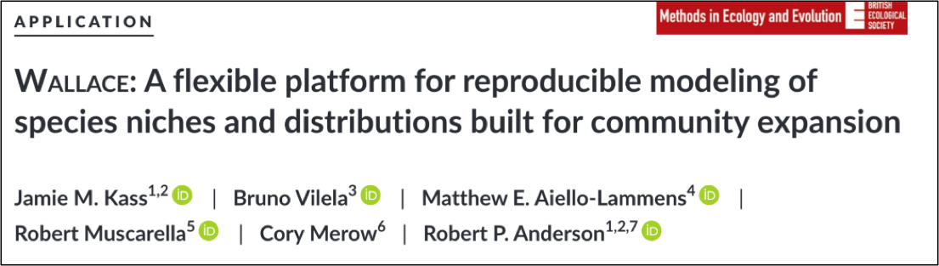
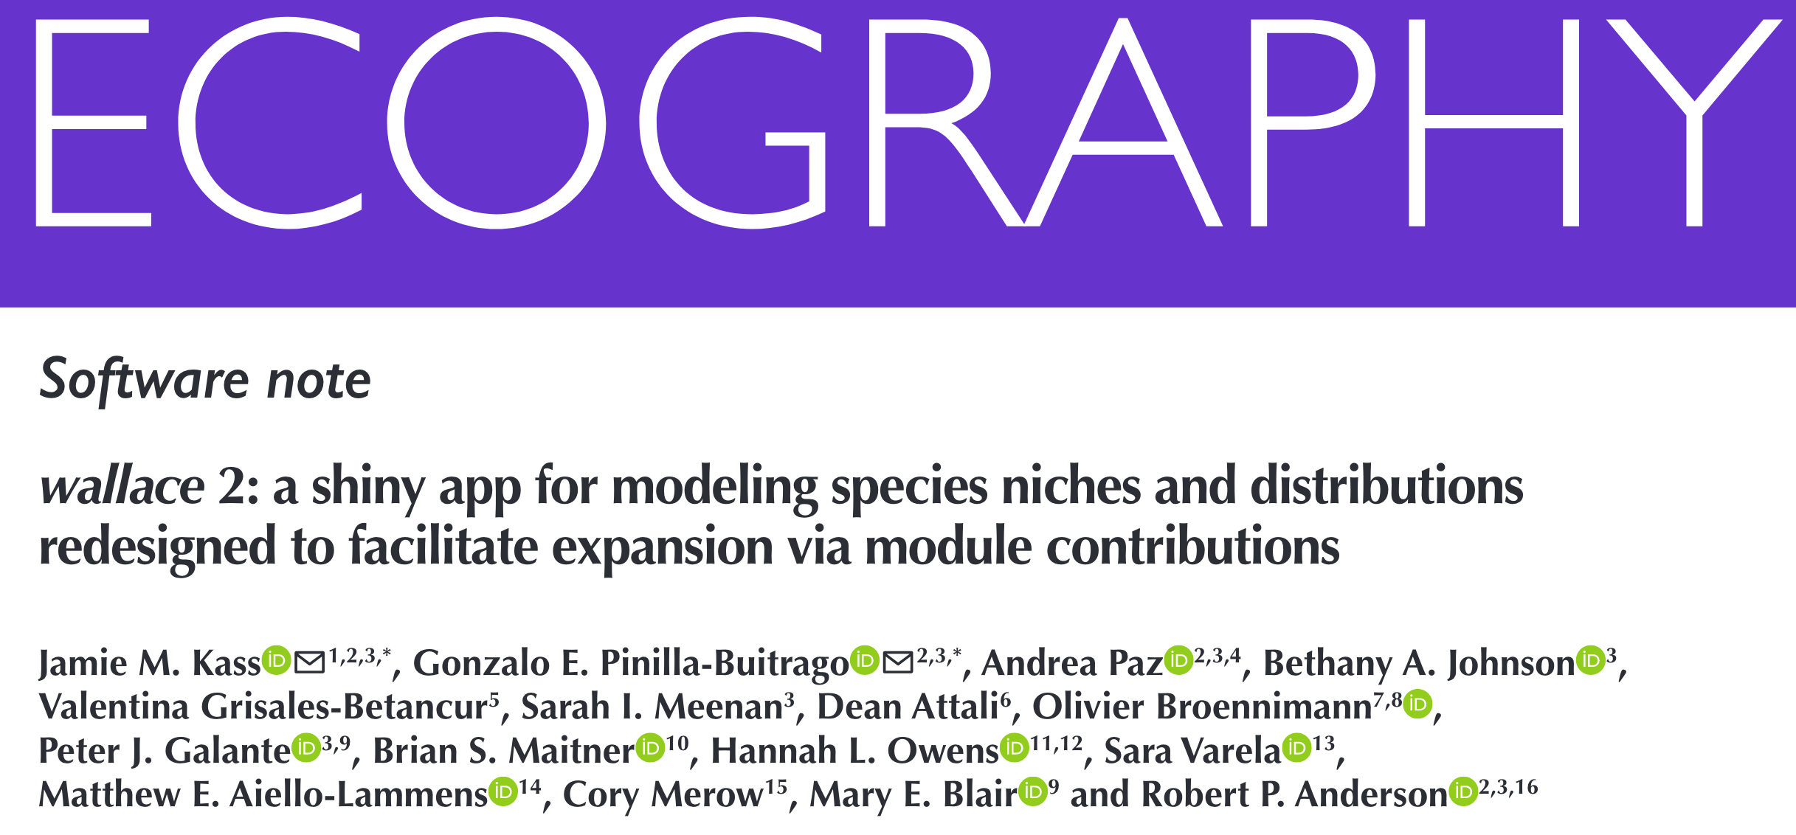
Wallace EcoMod
Characteristics
Open
Instructive
Flexible
Interactive
Reproducible
Expandable
Notes:
Image credit: screenshot of Wallace journal articles.

Slide 10
Wallace EcoMod
Open
Wallace code is open and free
  You can get it from CRAN V.2: install.packages(“wallace”)
  In Github the development version (soon V.3)

Slide 11
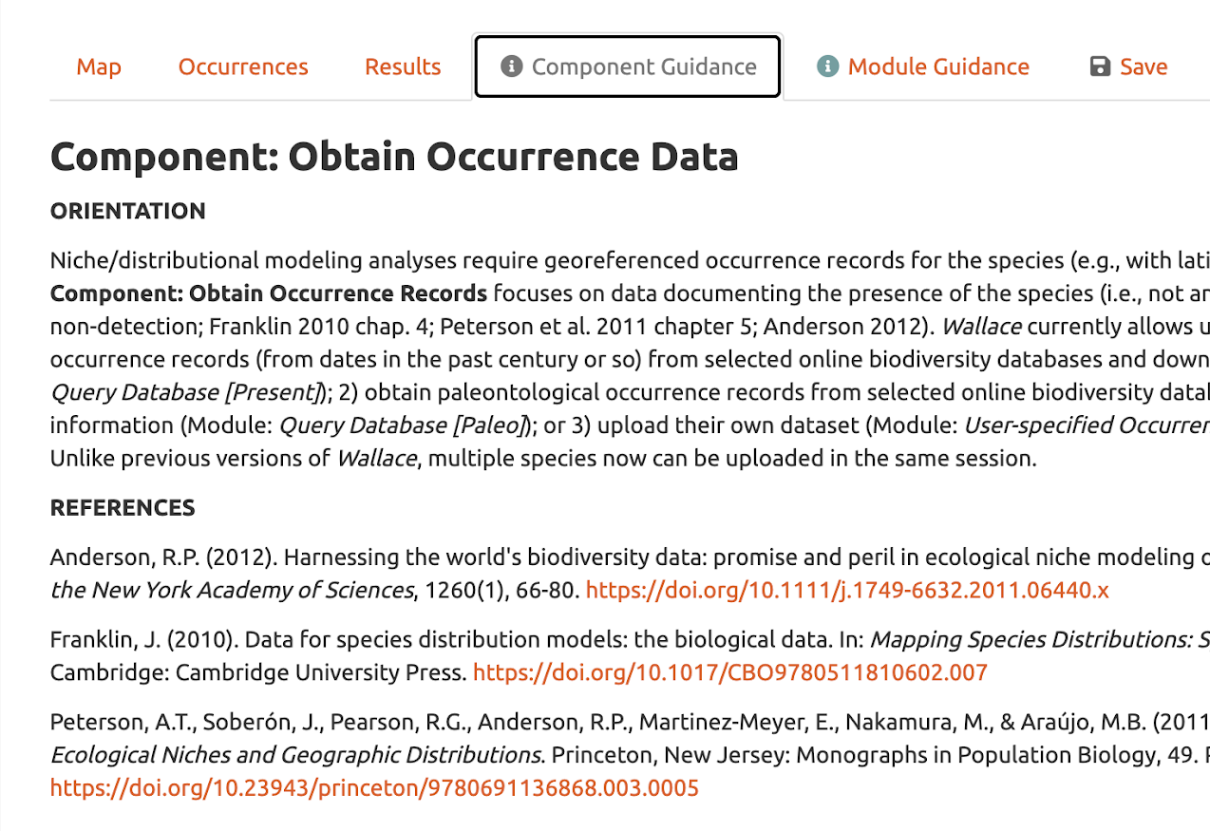
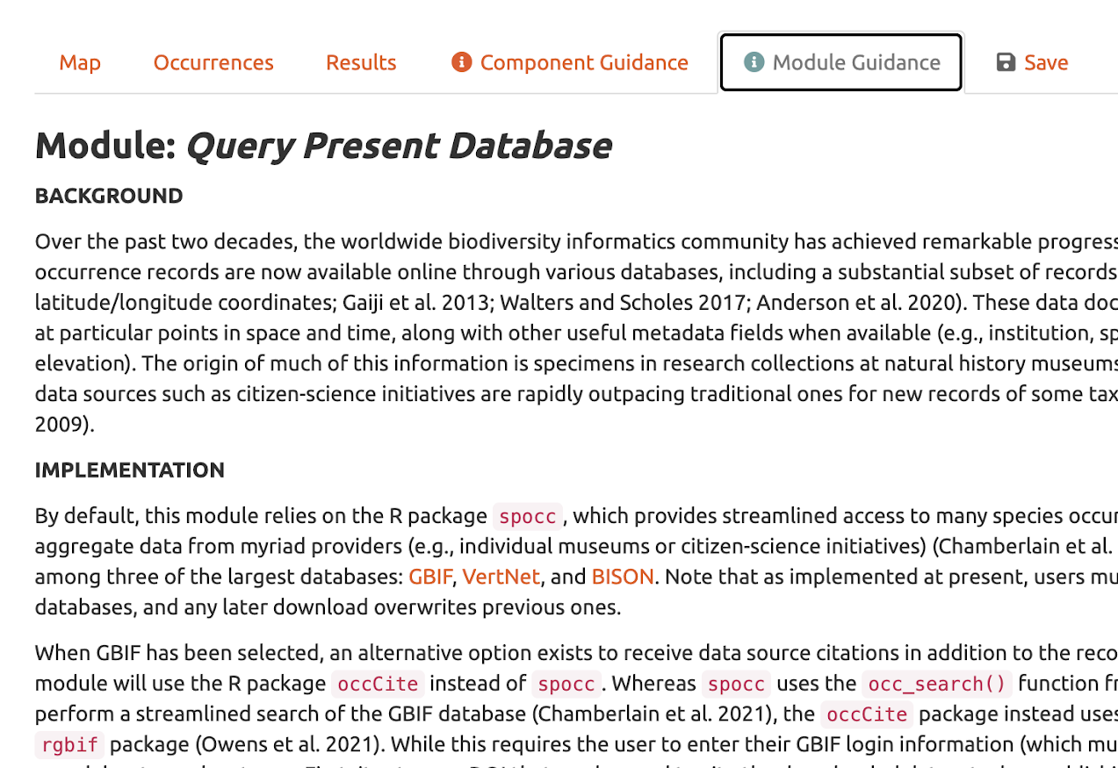
Wallace EcoMod
Instructive
Notes:
Image credits: screenshots from Wallace.

Slide 12
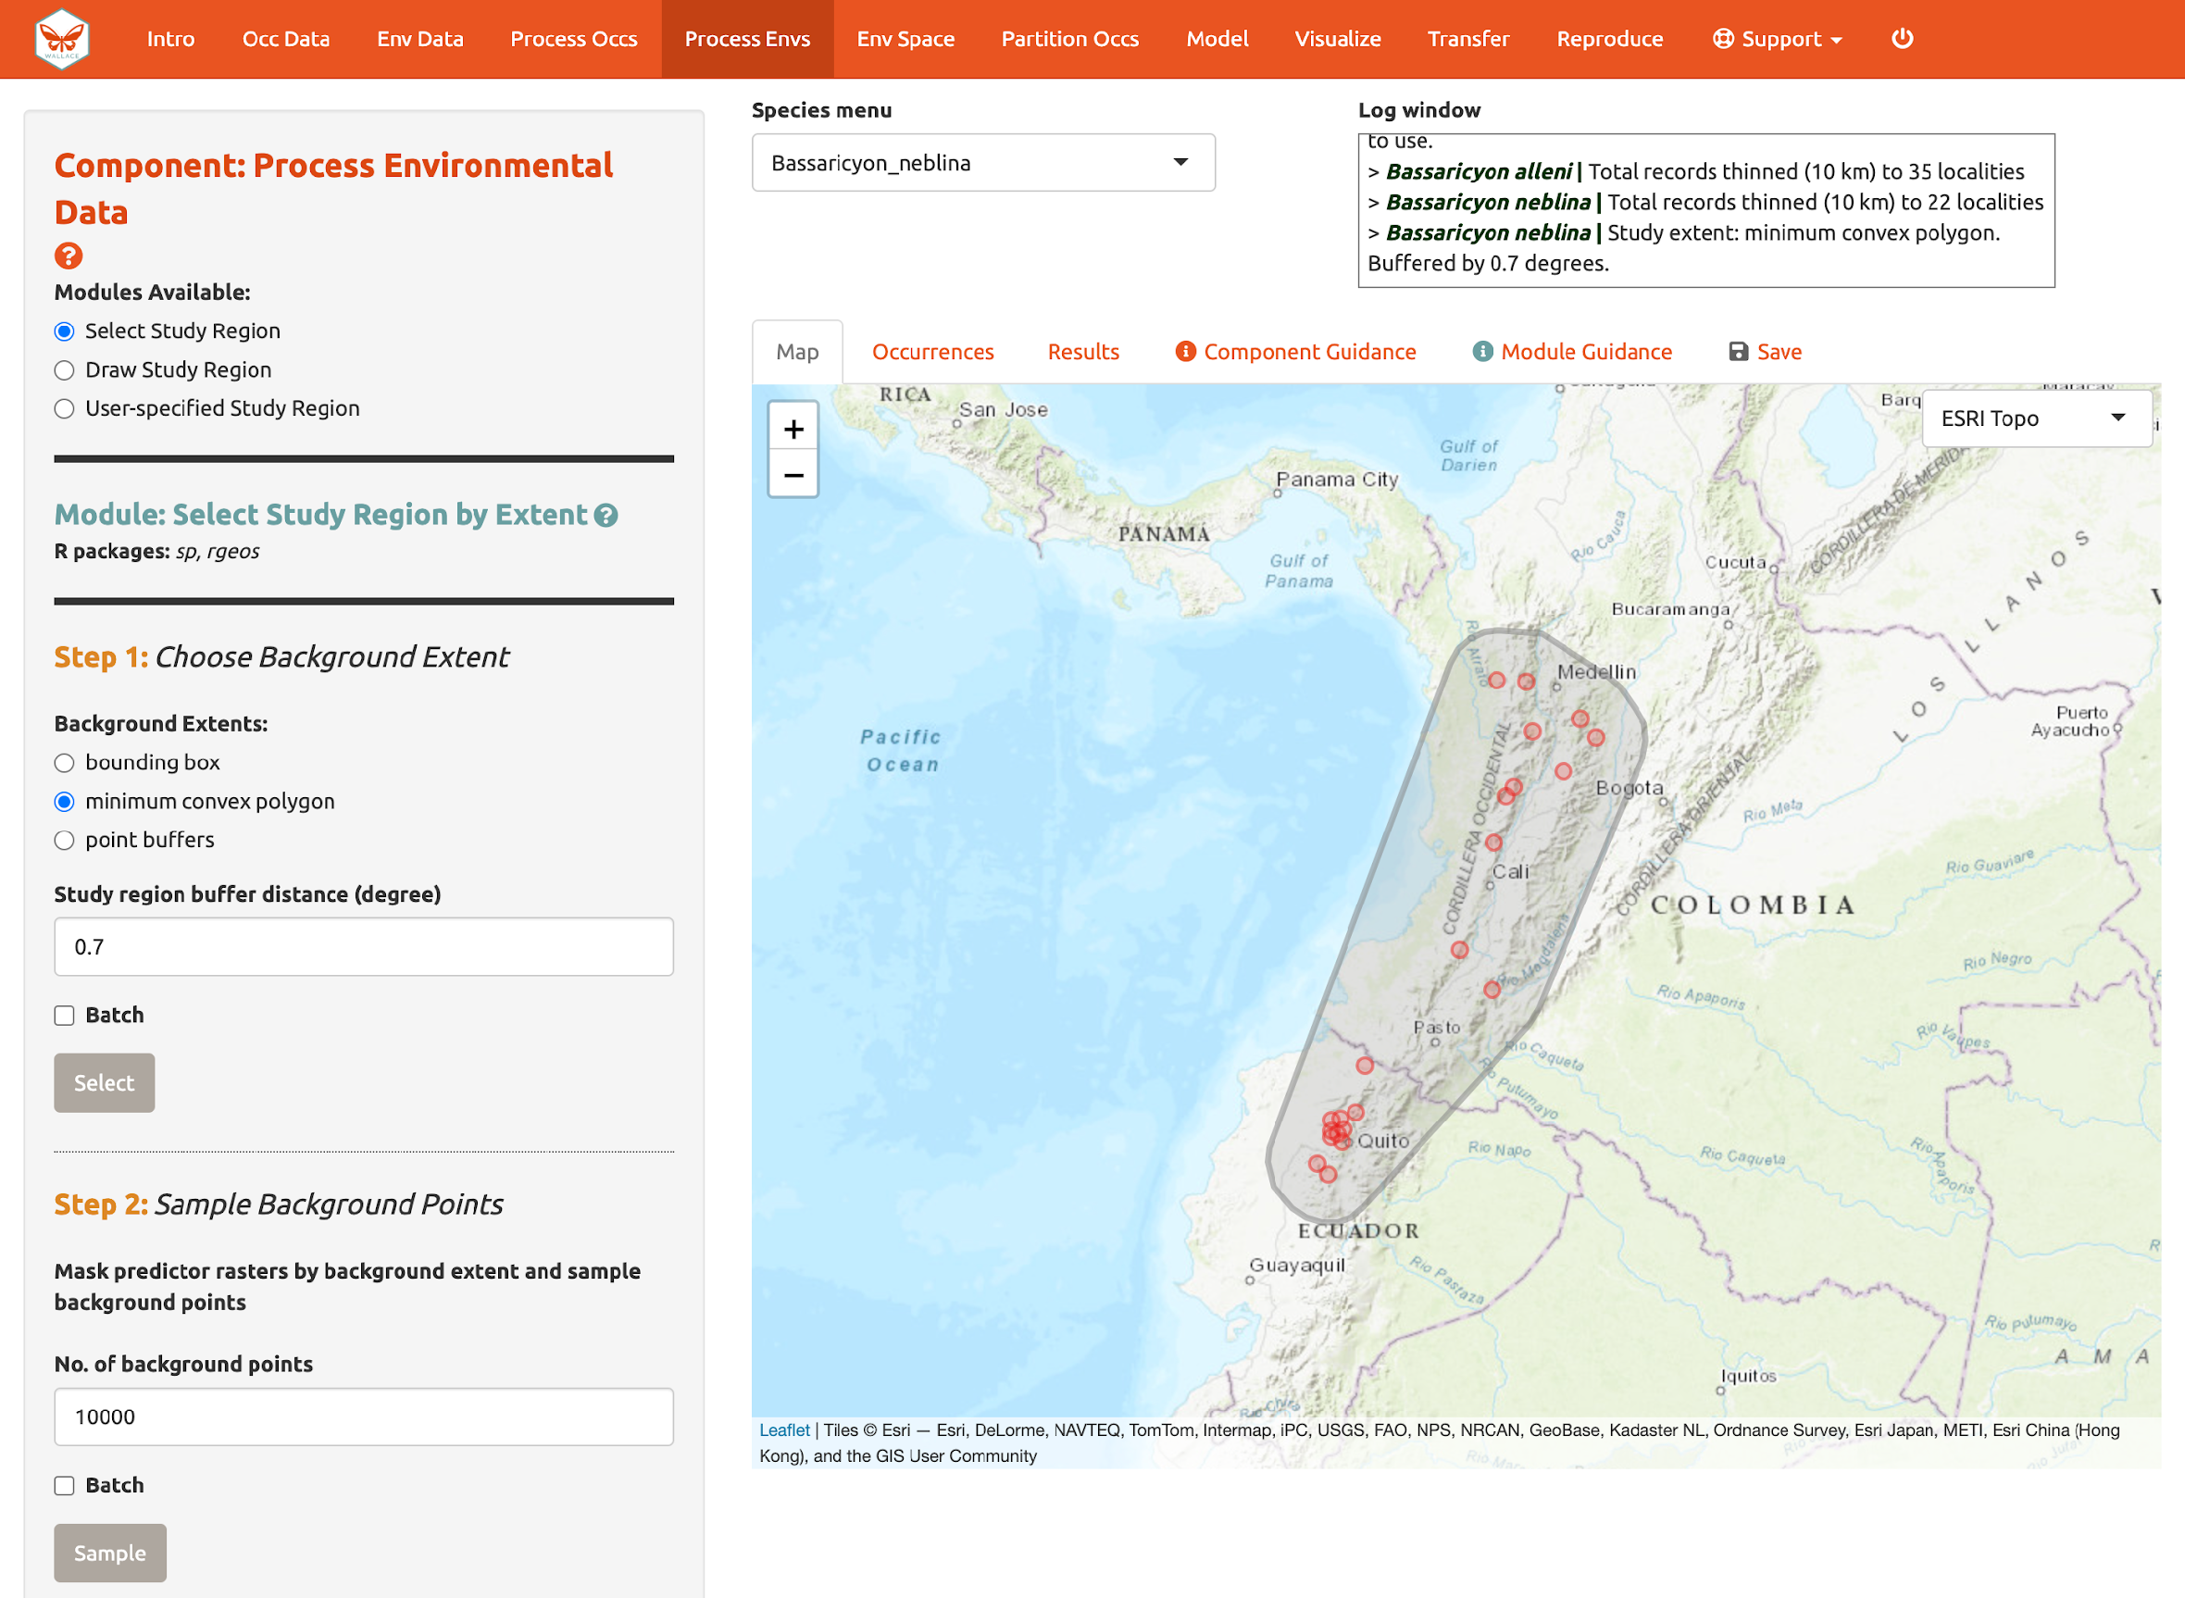
Wallace EcoMod
Flexible
Multiple default options
+ User options
Notes:
Wallace is flexible at every step of the process allows for multiple default options and in some cases for user options.
Here an example on choosing the background extent user can select from default options, draw a polygon or load a polygon from their computer.
Image credit: screenshots from Wallace.

Slide 13
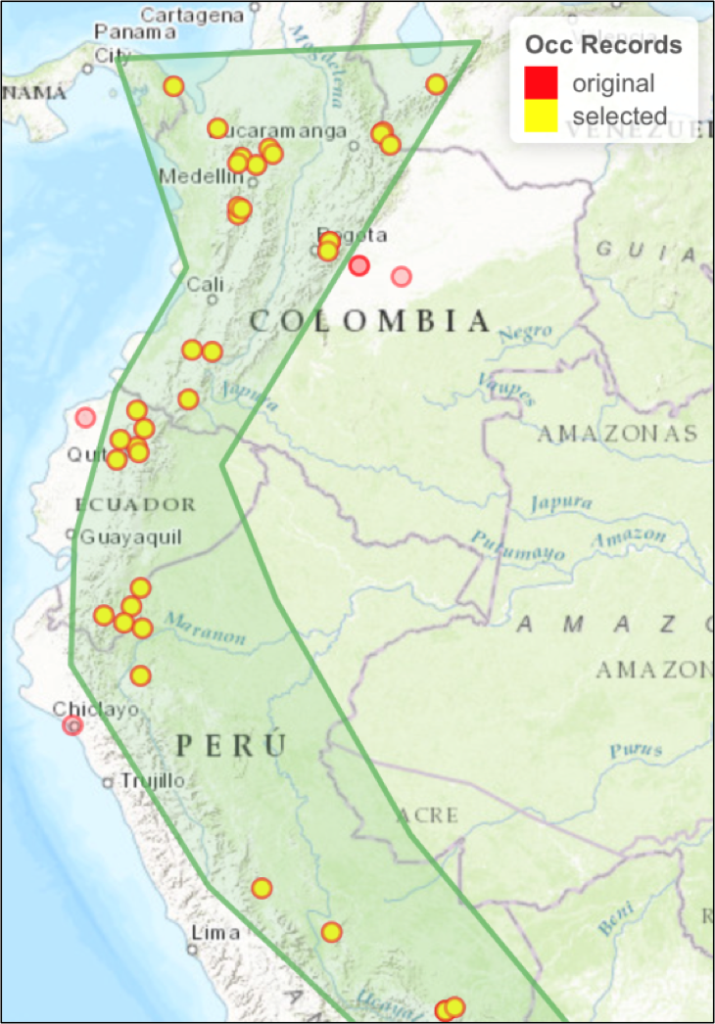
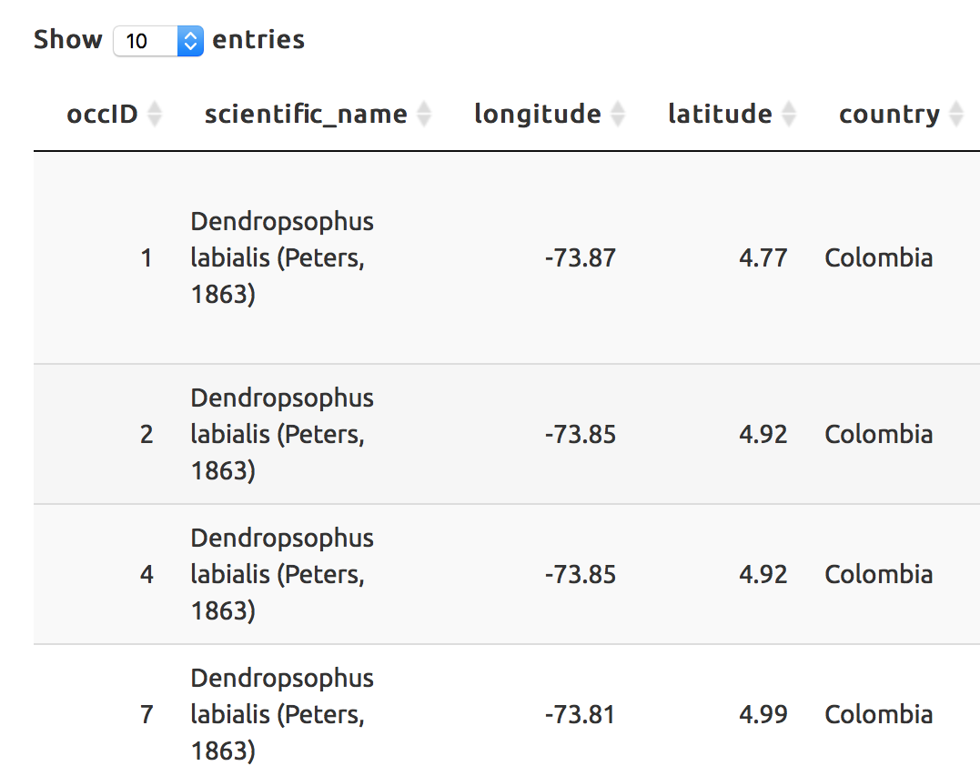
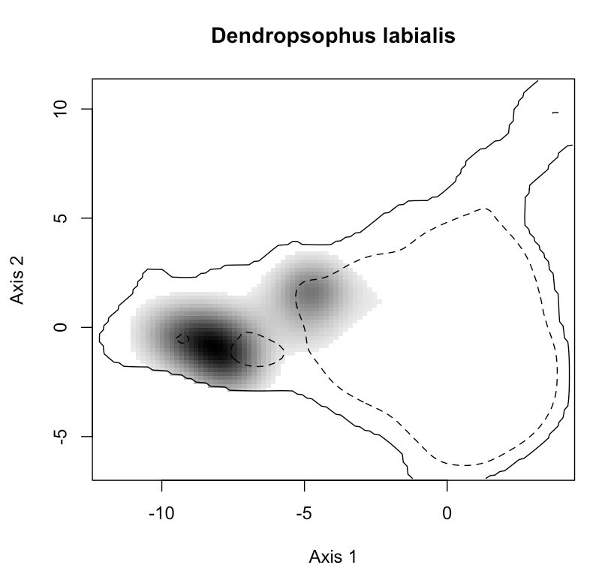
Wallace EcoMod
Interactive
Notes:
Image credits: screenshots from Wallace.

Slide 14
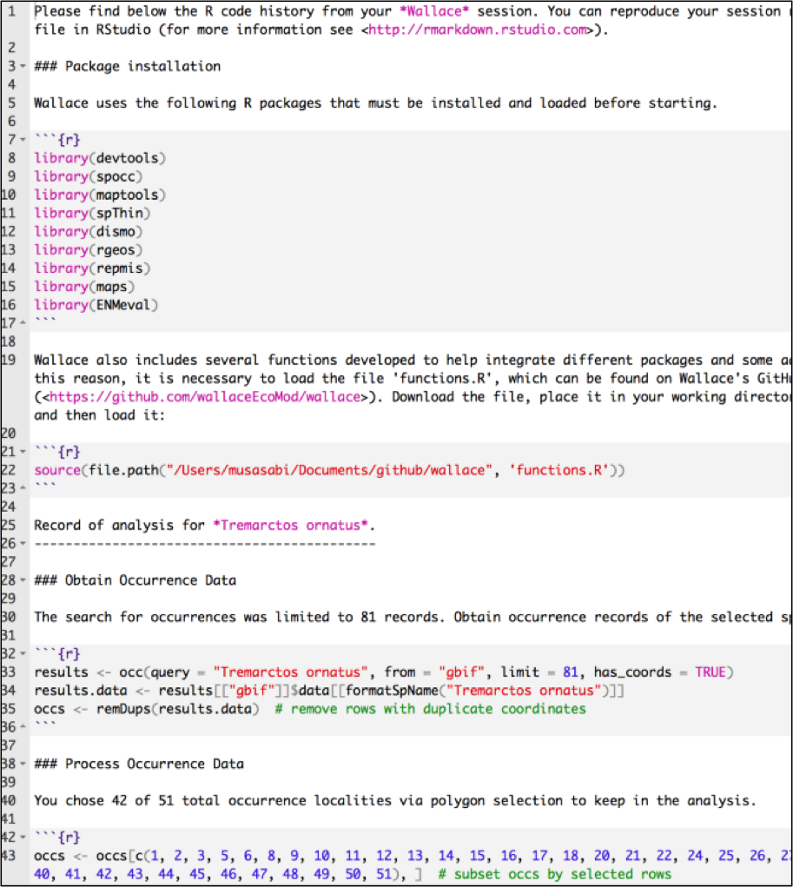
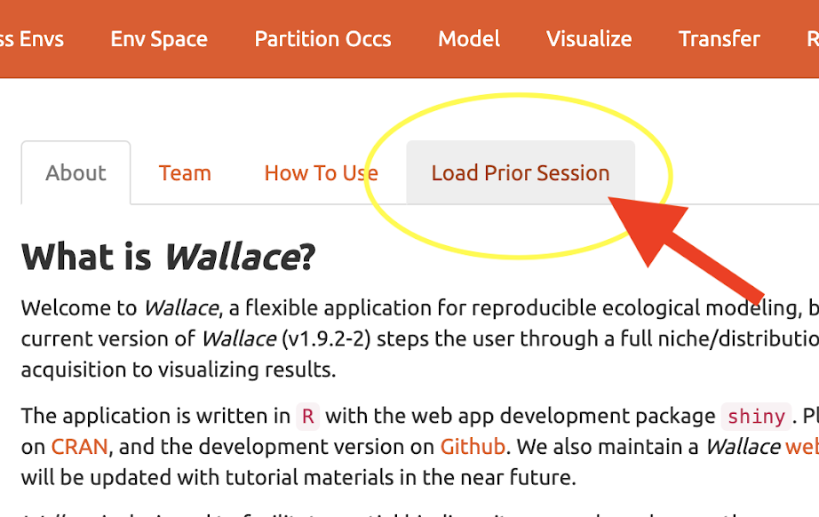
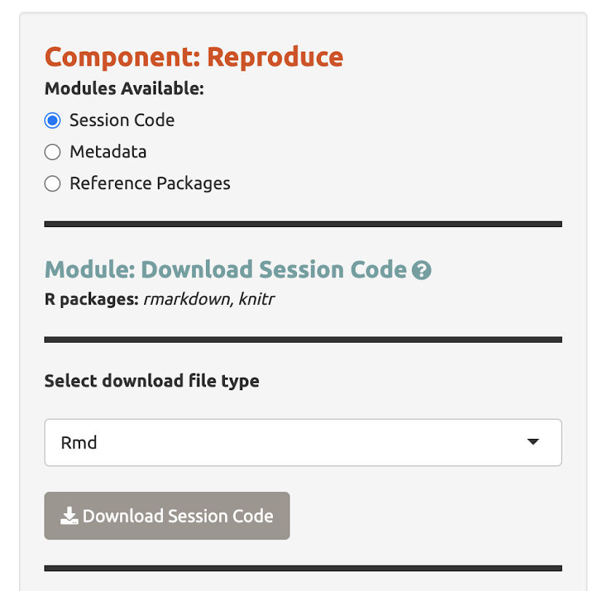
Wallace EcoMod
Reproducible
Wallace provides the workflow in the form of code
Wallace allows for storing your work and restart later
Notes:
Image credits: screenshots from Wallace and RMD.

Slide 15
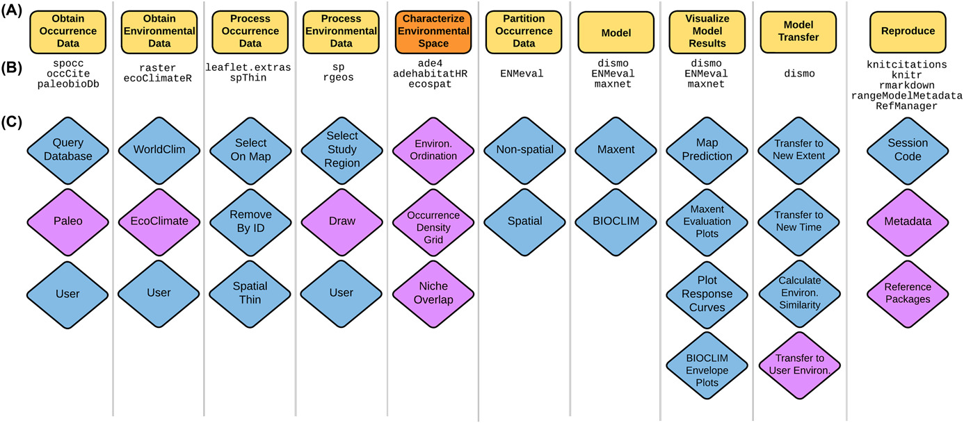
Wallace EcoMod
Expandable
Components
Modules

Slide 16
& speaking of expandable…
Wallace’s future V.3…
We have added options to work with multiple species at the time and improved downloading and saving options (V.2)

Slide 17
New components and modules!
New databases can be accessed through Wallace (BIEN)
A module allowing for GBIF downloads with more information (DOI, sources)
In collaboration with several researchers we now have added modules to download climatic data past and present from EcoClim.
New component for niche comparisons between species (Env Space)
New component for reproducing results (both outside and inside Wallace)

Slide 18
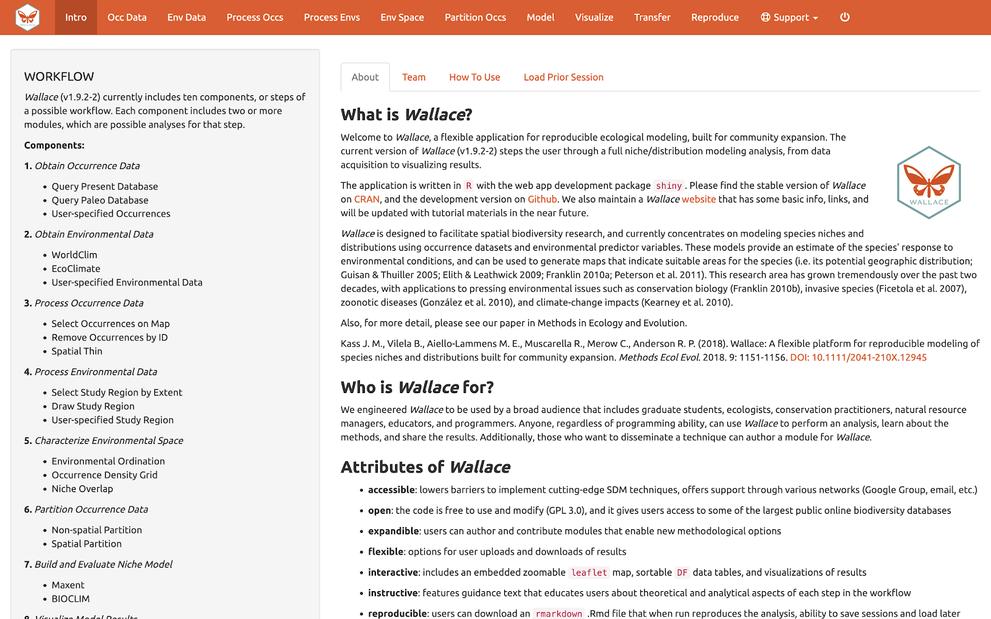
Wallace EcoMod
Components
1
2
3
4
5
6
7
8
9
10
Obtain Occurrence Data
Obtain Environmental Data
Process Occurrence Data
Process Environmental Data
Characterize Environmental Space
Partition Occurrence Data
Build and Evaluate Niche Model
Visualize Model Results
Model Transfer
Reproduce

Slide 19
The Wallace Team
Jamie M. Kass, Andrea Paz , Gonzalo E. Pinilla-Buitrago, Bethany A. Johnson,
Valentina Grisales-Betancur, Sarah I. Meenan, Dean Attali, Mary E. Blair,
Olivier Broennimann, Peter J. Galante, Brian S. Maitner,
Hannah L. Owens, Sara Varela, Matthew E. Aiello-Lammens, Cory Merow,
Robert P. Anderson
Contact us
Website: https://wallaceecomod.github.io/
Google Group: https://groups.google.com/forum/#!forum/wallaceecomod
Email: wallaceecomod@gmail.com
GitHub: https://github.com/wallaceecomod/wallace

Slide 20
Slides about V3 expansion
Notes:
From here on only use if you will be working with the development version (or if V3 has been released)

Slide 21
& speaking of expandable…
Today we will take a peak at Wallace’s future V.3
We have added options to work with multiple species at the time and improved downloading and saving options (V.2)

Slide 22
Conservation components
Based on two R packages developed by our team to post-process SDMs
These packages are MaskRangeR and ChangeRangeR and are both available on CRAN

Slide 23
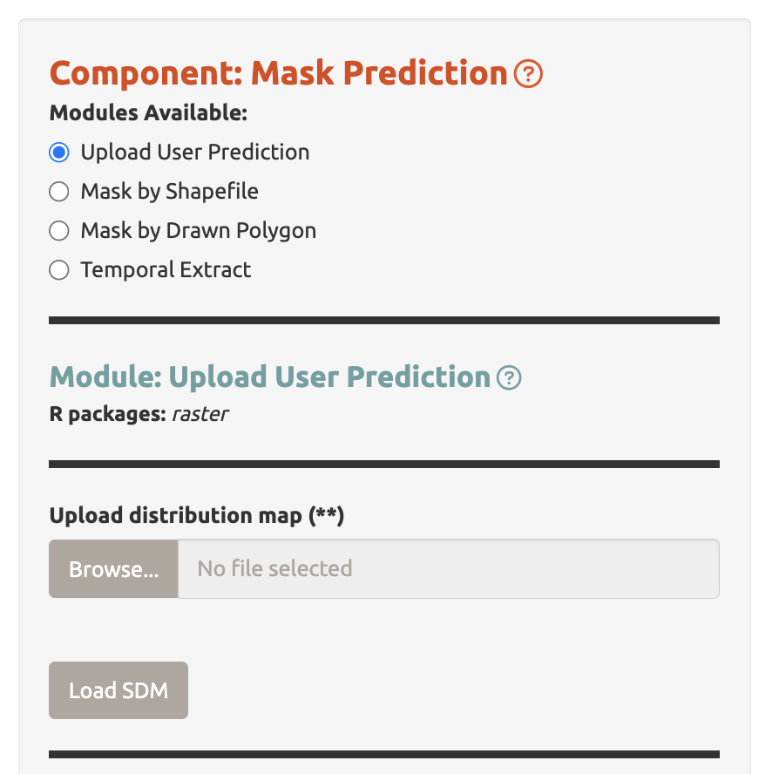
Conservation components
Upload a raster prediction built outside of Wallace or from a previous session

Slide 24
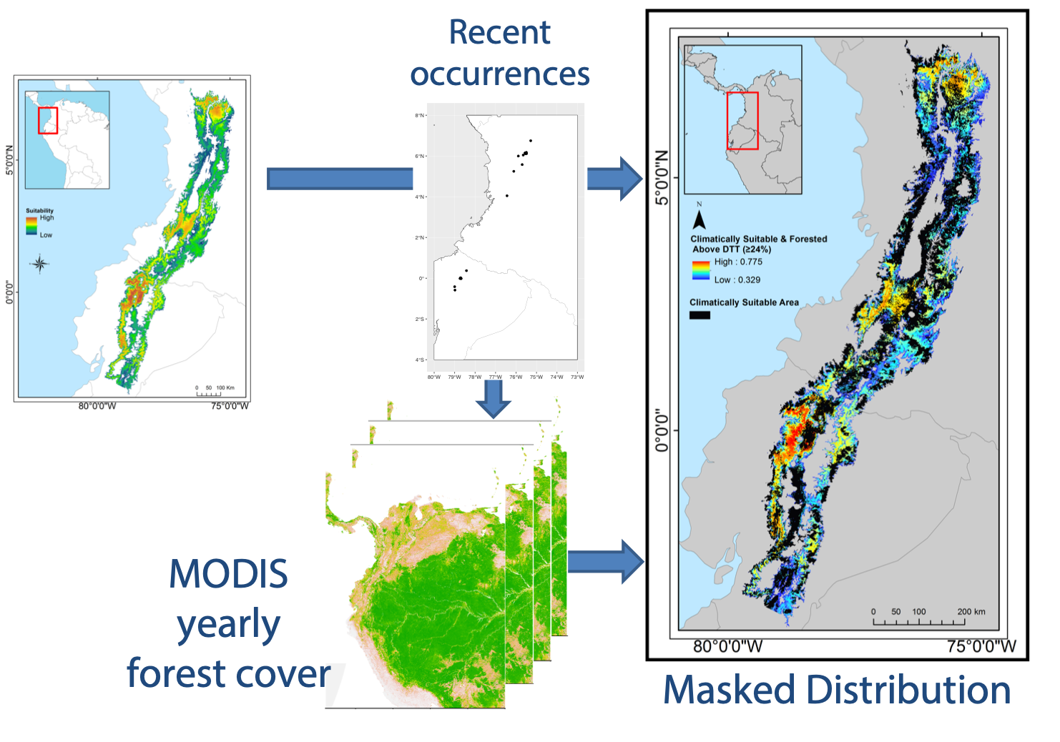
Conservation components
Post-processing models
Based on user expertise: Add or remove areas of presence
GIS data: Cut with a raster or polygon (e.g deforestation)
Notes:
Image credits: Adapted from Gerstner, B., J. Kass, R. Kays, K. Helgen, and R. Anderson. 2018. Revised distributional estimates for the recently discovered olinguito (Bassaricyon neblina), using museum and citizen science records. Journal of Mammalogy 99:321–332.

Slide 25
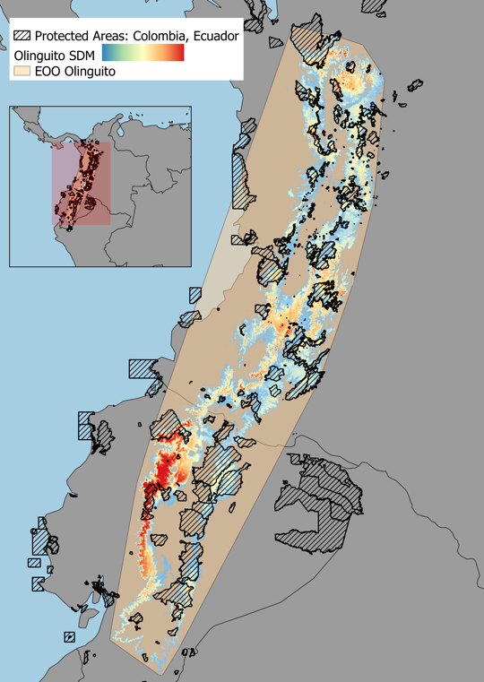
Conservation components
Estimating areas and area changes
Range, AOO-EOO (UICN)
Area change according to GIS data (deforestation, mining etc.)
Percentage of distribution given a certain category (NP, mining concessions etc.)
Notes:
Image credit: Adapted from Gerstner, B., J. Kass, R. Kays, K. Helgen, and R. Anderson. 2018. Revised distributional estimates for the recently discovered olinguito (Bassaricyon neblina), using museum and citizen science records. Journal of Mammalogy 99:321–332.

Slide 26
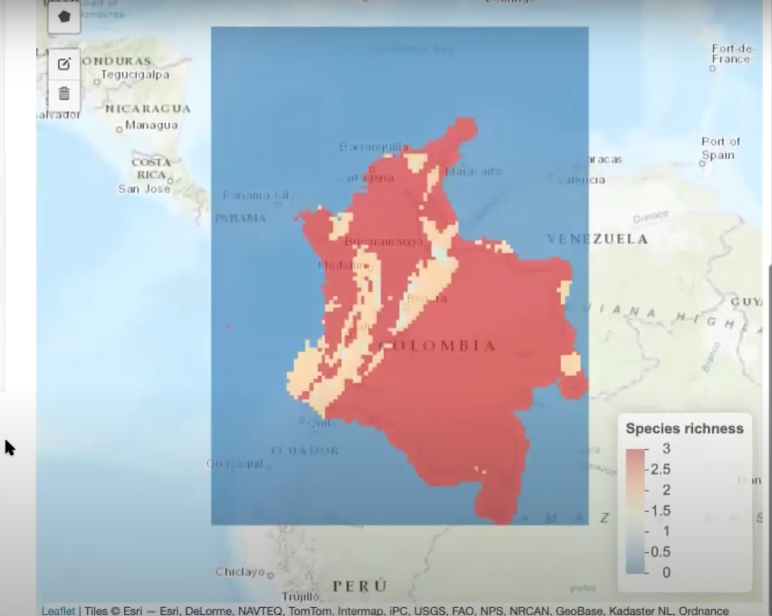
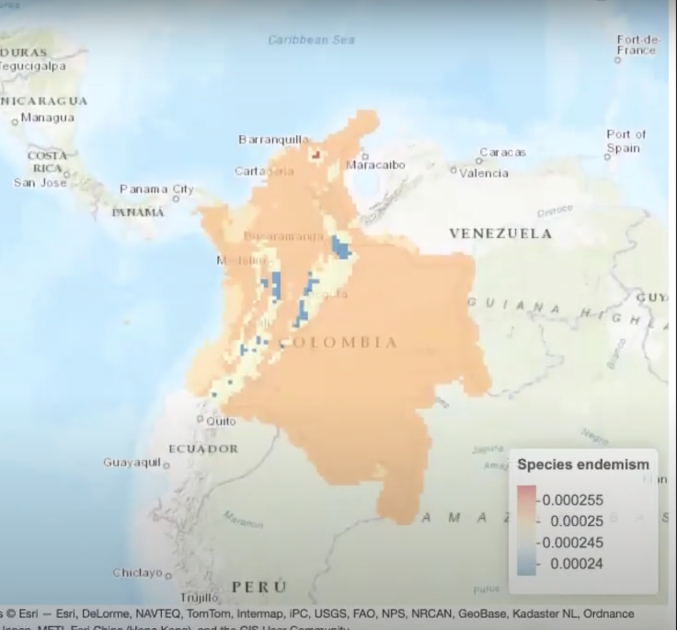
Conservation components
Diversity maps based on distribution models:
Species richness
Endemism
(in the future, phylogenetic measures)
Notes:
Image credits: screenshots from Wallace of the diversity component results for a mockup example.

